Slide 1
Understanding and Benefiting from the Publishing Process
Maarten van Twisk, Senior Publisher Economics & Marketing

Slide 2
My portfolio
Economic Analysis and Policy
Economics & Human Biology
Games and Economic Behavior
Information Economics and Policy
International Journal of Industrial Organization
International Review of Economics Education
Journal of Behavioral and Experimental Economics
Journal of Economic Behavior & Organization
Journal of Economic Psychology
Journal of Health Economics
Labour Economics
The Journal of the Economics of Ageing
Economics of Education Review
Journal of Economic Theory
Australasian Marketing Journal
Industrial Marketing Management
International Journal of Research in Marketing
Journal of Business Research
Journal of Consumer Psychology
Journal of Interactive Marketing
Journal of Retailing
Journal of Retailing and Consumer Services

Slide 3
Agenda
Introduction to scholarly publishing
Building an effective manuscript
Author rights
Getting your article noticed
Q&A

Slide 4

Academic publishing The publishing cycle
30-60% rejected by > 13,000
editors
Solicit &
manage
submissions
>700 million
downloads by
>11 million
researchers in
>120 countries!
557,000+ reviewers
Publish & Disseminate
Manage Peer Review
12.6 million articles available
365,000 articles
accepted
Production
Edit & prepare
Notes:
(NOTE TO SPEAKER: VIEW IN SLIDESHOW AND USE ANIMATIONS FOR BEST EFFECT TO TELL THE STORY)
Let’s look at this illustration of the publishing cycle at one of the worlds’ leading STM publishers: Elsevier – and consider some staggering figures. Elsevier is a world-leading provider of information solutions that enhance the performance of science, health, and technology researchers, empowering them to make better decisions, deliver better care, and sometimes make groundbreaking discoveries, that advance the boundaries of knowledge and human progress. Elsevier provides web-based, digital solutions — among them ScienceDirect, Scopus, Elsevier Research Intelligence, and ClinicalKey — and publishes nearly 2,200 journals, including The Lancet and Cell, and over 25,000 book titles, including a number of iconic reference works. 12.6 million articles are currently archived in our system. Depending on the journal, on average 30-60% are rejected directly by one of the 13,000 editors they work with. Those articles that are not rejected upfront will undergo peer review. Currently they work with around 560,000 reviewers to evaluate these articles. Of these, around half get accepted after minor or major revision. Overall 365,000 articles are in the end accepted by the editors each year and “produced”, which means typeset, posted online, linked to the various external platforms like PubMed, promoted to the appropriate audience and of course archived for future use. 12.6 million articles are now available and have been downloaded over 700 million times, by 11 million researchers, across more than 120 countries.

Slide 5
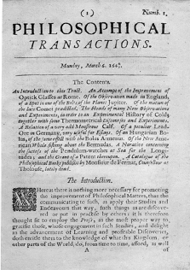

Role of scientific publications
Registration
The timestamp to officially note who submitted scientific results first
Certification
Perform peer-review to ensure the validity and integrity of submissions
Dissemination
Provide a medium for discoveries and findings to be shared
Preservation
Preserving the minutes and record of science for posterity
Notes:
Oldenburg saw four roles that the journal served for the Society:
REGISTRATION: [We must be] very careful of registering as well the person and time of any new matter.., as the matter itself; whereby the honor of ye invention will be inviolably preserved to all posterity. [Oldenburg, 24 November 1664]
The publisher acts as an independent, neutral third party to track the minutes of science.
2. CERTIFICATION: “[Phil. Trans. should be] licensed under the charter by the Council of the Society, being first reviewed by some of the members of the same.” [R.Soc. Order in Council 1/3/1665]
The publisher provides the stamp of approval and is a final guarantor of quality by actively managing editors and editorial boards.
3. DISSEMINATION: all Ingenious men will be thereby encouraged to impart their knowledge and discoveryes [Oldenburg, 3 December 1664]
Publishers provide for the fundamental journal production and distribution.
4. PRESSERVATION: [I should not] neglect the opportunity of having some of my Memoirs preserv’d, by being incorporated into a Collection, that is like to be as lasting as useful [Boyle, 1665]
Publishers preserve and archive the record of science.
The original four roles of the publisher have endured for over 300 years to the present day. Although we may use different methods to carry out these roles, they remain fundamentally unchanged.

Slide 6
What are the responsibilities of a Publisher?
Organization:
Appointing editors and editorial board
Providing the editorial infrastructure (peer-review process)
Arranging the publication of accepted manuscripts
Distribution and promotion of journals to readers/ libraries
Archiving all published articles
Dealing with ethical and copy right issues

Slide 7
What are the responsibilities of an Editor?
Scientific responsibility:
Defining the aims and scope of the journal
Handling new submissions
Sending out appropriate papers to reviewers
Accepting or rejecting papers
Communication with authors and reviewers
Advising on strategy and direction of the journal

Slide 8
What to consider when building an effective manuscript

Slide 9
What are your personal reasons for publishing?
Get funding?
Get promoted?
PhD degree?
…???
However, editors, reviewers, and the research community don’t consider these reasons when assessing your work.

Slide 10


What to publish:
New and original results or methods
Reviews or summaries of particular subject
Manuscripts that advance the knowledge and understanding in a certain scientific field
What NOT to publish:
Reports of no scientific interest
Out of date work
Duplications of previously published work
Incorrect/unacceptable conclusions
You need a STRONG, EFFECTIVE manuscript to present your
contributions to the scientific community.

Slide 11
What is a strong manuscript?
Has a novel, clear, useful, and exciting message
Presented and constructed in a logical manner
Reviewers and editors can grasp the scientific significance easily
Editors and reviewers are all busy scientists. Make things easy to save their time.
Notes:
The scientific message must be clear, useful, and exciting
The author’s messages must be presented and constructed in a logical manner. The reader should arrive at the same conclusions as the author. The format chosen should best showcase the author’s material.
Readers, reviewers, and editors should be able to easily grasp the scientific significance of the research
Editors, reviewers and readers all want to save time and not waste it.

Slide 12
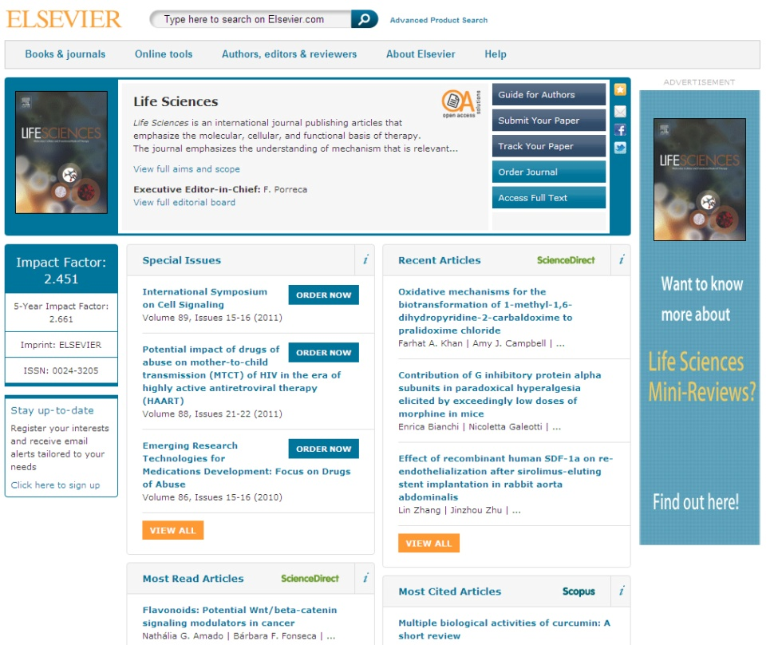
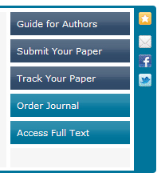
Read the ‘Guide for Authors’!
You can find the Guide for Authors on the journal homepage on Elsevier.com

Slide 13

Typical Structure of a Research Article
Title
Abstract
Keywords
Main text (IMRAD)
Introduction
Methods
Results
And
Discussions
Conclusion
Acknowledgement
References
Supplementary Data
Make them easy for indexing and searching! (informative, attractive, effective)
Journal space is not unlimited.
Your reader’s time is scarce.
Make your article as concise as possible - more difficult than you imagine!

Slide 14

The process of writing – building the article
Title & Abstract
Conclusion
Introduction
Methods
Results
Discussion
Figures/tables (your data)

Slide 15
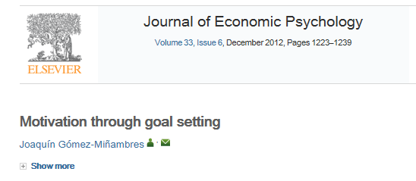
Title
A good title should contain the fewest possible words that adequately describe the contents of a paper.
Effective titles
Identify the main issue of the paper
Begin with the subject of the paper
Are accurate, unambiguous, specific, and complete
Are as short as possible
Articles with short, catchy titles are often better cited
Do not contain rarely-used abbreviations
Attract readers - Remember: readers are the potential authors who will cite your article

Slide 16
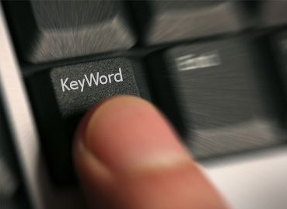
Keywords
In an “electronic world”, keywords determine whether your article is found or not!
Avoid making them
too general (“drug delivery”, “mouse”, “disease”, etc.)
too narrow (so that nobody will ever search for it)
Effective approach:
Look at the keywords of articles relevant to your manuscript
Play with these keywords, and see whether they return relevant papers, neither too many nor too few – a good guideline.

Slide 17
Abstract
Tell readers what you did and the important findings
One paragraph (between 50-250 words) often, plus Highlight bullet points
Advertisement for your article, and should encourage reading the entire paper
A clear abstract will strongly influence if your work is considered further
Graphite intercalation compounds (GICs) of composition CxN(SO2CF3)2 · δF are prepared under ambient conditions in 48% hydrofluoric acid, using K2MnF6 as an oxidizing reagent. The stage 2 GIC product structures are determined using powder XRD and modeled by fitting one dimensional electron density profiles.
A new digestion method followed by selective fluoride electrode elemental analyses allows the determination of free fluoride within products, and the compositional x and δ parameters are determined for reaction times from 0.25 to 500 h.
What has been done
What are the main findings
Notes:
The abstract should just be one paragraph and should summarize the problem, the method, the results, and the conclusions.
The abstract acts as an advertisement for you article since it is freely viewable via search and indexing. You want to make it as catchy and impactful as possible.
An abstract written clearly will strongly encourage the reader to read the rest of your paper.
An example of an abstract is given here and is shown with the two distinct sections that are most important. Different journals have different requirements for the content of abstract. (Again, consult the Guide for Authors. ) But the two “whats” are essential. Make it interesting, and easy to understand without reading the whole article (avoid using jargon and uncommon abbreviations if possible)
Note that some journals ask for a graphical abstract.
Many authors write the abstract last so that it accurately reflects the content of the paper.

Slide 18

Introduction
The place to convince readers that you know why your work is relevant, also for them.
Answer a series of questions:
What is the problem?
Are there any existing solutions?
Which one is the best?
What is its main limitation?
What do you hope to achieve?
General
Specific

Slide 19
Methods / Experimental
Include all important details so that the reader can repeat the work.
Details that were previously published can be omitted but a general summary of those experiments should be included
Give vendor names (and addresses) of equipment etc. used
All chemicals must be identified
Do not use proprietary, unidentifiable compounds without description. State purity and/or supplier if it is important.
Present proper control experiments
Avoid adding comments and discussion
Write in the past tense
Most journals prefer the passive voice, some the active.
Consider use of Supplementary Materials
Documents, spreadsheets, audio, video, ...
Reviewers will criticise incomplete or incorrect method descriptions, and may even recommend rejection

Slide 20
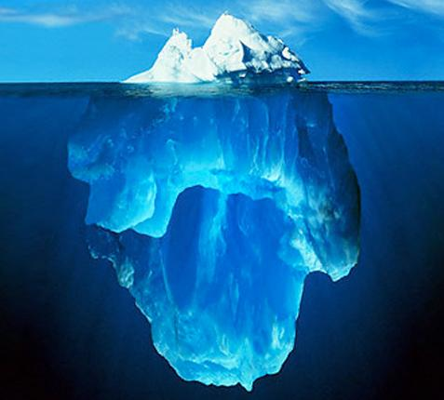
Results – what have you found?
The following should be included
the main findings
Thus not all findings. Decide what to share.
Findings from experiments described in the Methods section
Highlight findings that differ from findings in previous publications, and unexpected findings
Results of the statistical analysis

Slide 21

Results – Figures and tables
Illustrations are critical, because:
Figures and tables are the most efficient way to present results
Results are the driving force of the publication
Captions and legends must be detailed enough to make figures and tables self-explanatory
Figures and tables should not need further explanation or description in text. Less writing and less reading. Let your figures do the work instead of words.
"One Picture is Worth a Thousand Words"
Sue Hanauer (1968)

Slide 22
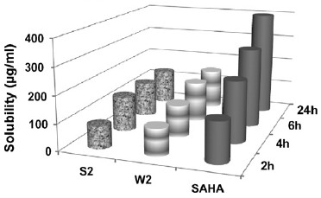
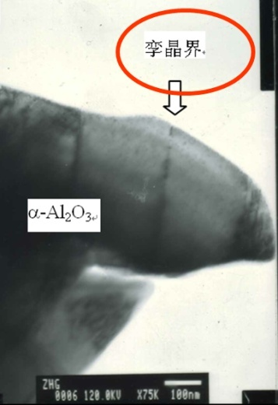
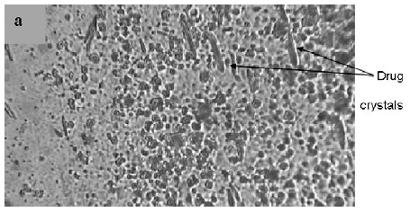
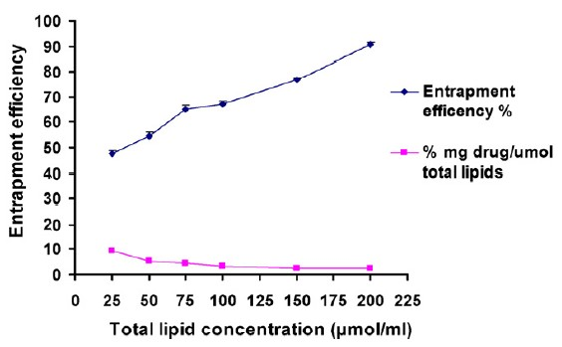
Results – appearance counts!
Un-crowded plots
3 or 4 data sets per figure; well-selected scales; appropriate axis label size; symbols clear to read; data sets easily distinguishable.
Text in photos / figures in English
Not in French, German, Chinese, Korean, ...
Use colour ONLY when necessary.
If different line styles can clarify the meaning, then never use colours or other thrilling effects.
If used, colour must be visible/distinguishable when printed in black & white.
Do not include long boring tables!

Slide 23
Discussion – what do your results mean?
It is the most important section of your article. Here you get the chance to SELL your data! Many manuscripts are rejected because the Discussion is weak
Check for the following:
Do your results relate to the original question or objectives outlined in the Introduction section?
Do you provide interpretation for each of your results presented?
Are your results consistent with what other investigators have reported? Or are there any differences? Why?
Are there any limitations?
Does the discussion logically lead to your conclusion?
Do not:
Make statements that go beyond what the results can support
Suddenly introduce new terms or ideas

Slide 24
Conclusions
Present global and specific conclusions
Indicate uses and extensions if appropriate
Suggest future experiments and indicate whether they are underway
Do not summarise the paper
The abstract is for that purpose
Avoid judgments about impact
Others can comment, you should not.

Slide 25
References: get them right!
Please adhere to the Guide for Authors of the journal
It is your responsibility, not of the Editor’s, to format references correctly!
Get help, save time - use Reference management software
Check
Referencing style of the journal
The spelling of author names, the year of publication
Punctuation use
Avoid citing the following if possible:
Personal communications, unpublished observations, manuscripts not yet accepted for publication
Articles published only in the local language, which are difficult for international readers to find

Slide 26
Author rights Content ownership
Notes:
I’ve written my paper but who technically owns it?

Slide 27






Elsevier author rights
Teaching: allowed to make copies of the article for use in classroom teaching
Educational materials: article can be included in the author’s institution or company e-course packs or company training
Scholarly sharing: copies of the article can be shared with research colleagues
Meetings/conferences: article can be presented and copies can be made for attendees
Further works: article can be used in compilations, expanded to book-form, or used in thesis or dissertation
Patent and trademark rights: for any invention disclosed or product identified
Notes:
Publisher agreements do vary and less restrictive terms do apply to those Elsevier titles that are published “Open Access”.
In Elsevier’s case though, our author agreements allow the following:
Copies of the article for classroom teaching
Articles to be included in coursepacks for Educational purposes
Copies of the article for sharing with fellow research colleagues
Copies of the article for those attending a meeting where you are presenting the article
Article can be expanded to book form or used in a thesis/dissertation
Article can be used for any patent and trademark rights.

Slide 28

Other allowances and restrictions (I)
Elsevier’s posting allowances:
Pre-print version of article to internet websites
Revised personal version of text of final article to author’s personal or institutional website or server
According to funding body agreements (e.g. Wellcome Trust, HHMI, NIH)
Notes:
Publishers also typically spell out “Posting” allowances for authors.
In Elsevier’s case we allow:
Posting of pre-prints to internet websites including pre-print servers
Posting of a revised personal version of the text of the final journal article (to reflect changes made in the peer review process) to the author’s personal or institutional website or server.
Posting in accordance with agreements made between Elsevier and funding bodies such as the Wellcome Trust and HHMI. The link provided is to directly view all of the agreements Elsevier has in place with different funding bodies. (www.elsevier.com/fundingbodies)
Express prohibitions that would be considered commercial use of the article include:
Posting by companies for customers to use
Placing advertisements against the postings
Charging fees for access to postings or delivering postings to third parties
Any form of systematic distribution of the article.

Slide 29

Other allowances and restrictions (II)
Elsevier’s commercial purpose prohibitions
Posting by companies for customers to use
Placing advertisements against the postings
Charging fees for access to postings or delivering postings to third parties
Any form of systematic distribution of the article.
Notes:
Express prohibitions that would be considered commercial use of the article include:
Posting by companies for customers to use
Placing advertisements against the postings
Charging fees for access to postings or delivering postings to third parties
Any form of systematic distribution of the article.

Slide 30

Get noticed Promoting your researcher for maximum impact
Notes:
There are more than one million scientific articles are published every year. With that in mind, it is increasingly important for you as researchers to find efficient and impactful ways to make your research stand out from this growing crowd. This module provides you with the information on the best tools to use both from Elsevier and from the industry.

Slide 31
What are your personal reasons for publishing?
Get funding?
Get promoted?
PhD degree?
…???

Slide 32
You want to make sure your research gets the attention it deserves
40M
The volume of research articles is growing at an accelerated pace
For most researchers, it’s a real challenge to keep up with the literature
Your job: make sure your research doesn’t fall through the cracks!
0
1970
2013
7 hrs/week average time spent on literature
Notes:
Before we dive in, let’s take a step back and provide some background to explain why it’s so important to make your research stand out.
The number of published papers worldwide is growing at an accelerating pace. With such an impressive and ever-growing output, many researchers find it a challenge to keep up with the literature. In fact, research by Elsevier shows that, on average, researchers spend 7 hours per week on searching and reading the literature. This is a substantial portion of their time, and it’s no surprise that good research can sometimes fall through the cracks. Together it’s our job to make sure that doesn’t happen to your research but we will show you where small additional efforts from you can make a difference.

Slide 33
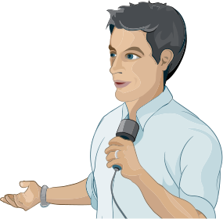


1. Preparing your article
2. Promoting your published article
3. Monitoring your article
Notes:
In this module you will learn what you can do to ensure your research gets the attention it deserves.
Promoting your research does not begin AFTER your manuscript is finished and has been published online. Promoting your research should be on your mind even whilst you are DOING it and writing up your paper. Promoting your research also continues some time after it has been published and the tracking the performance of your promotion activities will help drive improved results.
There are things that we as a publisher do and things you can do yourself.
Here we’ll look at what can you do when you are writing your paper, what can you do when it’s published and finally how can you monitor the results of your efforts.

Slide 34
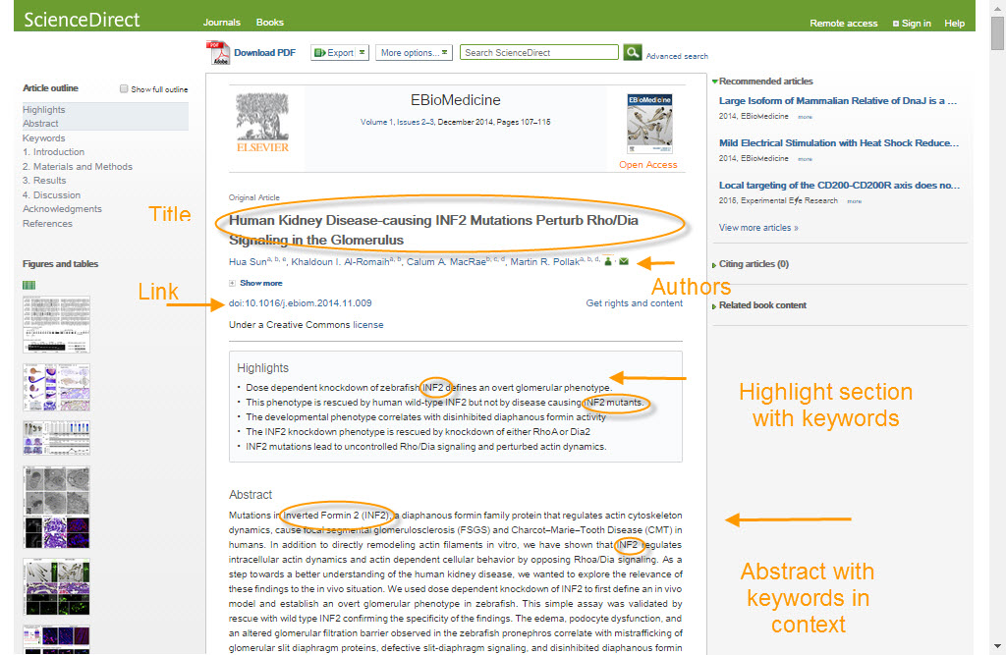
Preparing your article
Search Engine Optimization (SEO)
Notes:
Search Engine Optimization, or SEO, will help your article appear higher in the results returned by search engines like Google. There are a few guidelines to help you getting higher in the search results:
Use strong keywords in your titles and headings. Think about keywords that are both descriptive and specific to this particular paper. Remember that search engines see websites differently, and pay special attention to headings and titles.
Interlink your paper with other content on the web, e.g. other papers by proper citations but also by linking your article with data repositories where relevant.
Make sure the authorship information is complete and contains the details that other researchers might use when searching for somebody
Finally, pay special attention to the captions of images and tables, including strong keywords there as well.

Slide 35
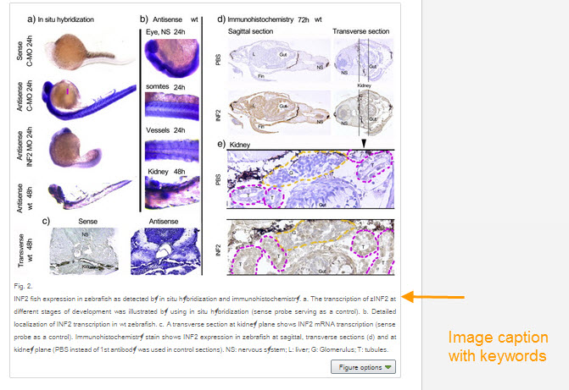
Preparing your article
Search Engine Optimization (SEO)
Notes:
Finally, pay special attention to the captions of images and tables, including strong keywords there as well.

Slide 36
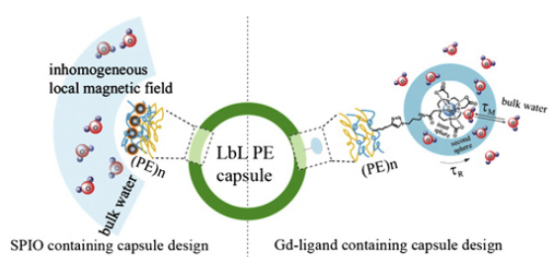
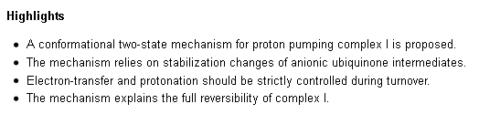
Preparing your article: Innovative abstracting formats
Help readers to quickly see why the paper is of interest
High Quality Graphical Abstracts
Highlights
Notes:
We’ve introduced new forms of content that are specifically designed for efficient communication of the most important points of your paper, so that researchers that are interested in your work can quickly see that this is a paper they should read.
In many disciplines, Graphical Abstracts are a very effective way of visually summarizing the key point of a paper.
Also bullet-point Highlights are a great way to capture the key points of a paper. These highlights are consistently ranked as one of the best liked features from the Article of the Future project.

Slide 37
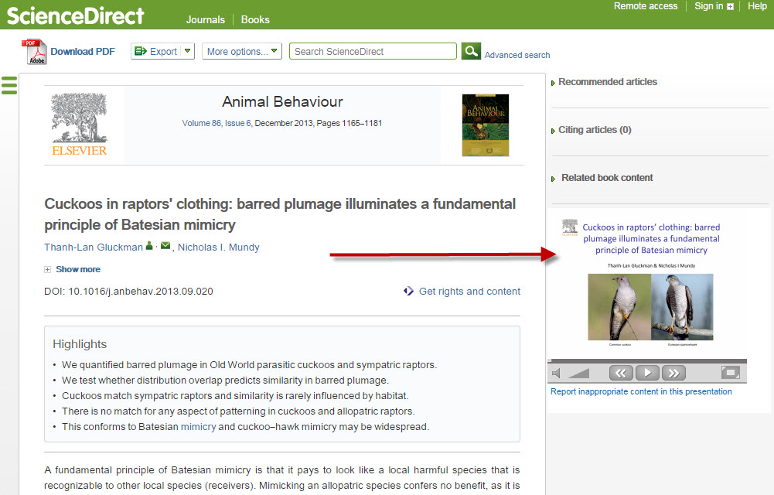
Preparing your article
AudioSlides
Notes:
AudioSlides are short, webcast-style presentations, which allow you to present your research in your own words. Elsevier offers you the option of creating your own unique AudioSlides presentation which complement your research and provides readers with a short and concise overview of the article content. These appear alongside your article once it is published on Elsevier’s ScienceDirect platform. AudioSlides are free to access and easy to share, independently from the article, with colleagues, (influential) bloggers and on social media including YouTube.

Slide 38
Promoting your article
3. Share links to your article
Customized short link with free access
Link from university website to boost SEO
Notes:
Sharing your research and findings can help you make a greater impact in your community, leading to better collaborations and potential new ideas and innovations. Millions of researchers have access to your formal publication hosted on ScienceDirect helping users to find, access, and cite your research using the best available version. Elsevier will send you a ‘share link’: a personal, customized short link that you will receive after final publication of your article. It provides 50 days free access to your newly-published article on ScienceDirect to anyone clicking on the link. We encourage you to share this link on social media or on your institutional webpage.
The more links there are to your article from a range of relevant websites, such as your university website, the more readers you’ll attract and the higher it will appear on search engine results.

Slide 39


Promoting your article
Social media: Twitter
Follow other researchers
Post regularly and respond promptly
Retweet
Use images
Social media: Facebook
Create a ‘fan’ page
Invite fellow researchers
Share images, videos, AudioSlides
Link to your articles
Discuss and ask for feedback
one mention every seven seconds
Notes:
Every day, scholarly articles receive 12,000 new mentions across social media, news and blogs: that’s one mention every seven seconds! It’s a powerful medium for reaching your potential readers. You don’t have to be on all social media – it can be best to find one or two channels that suit you and your purposes.
Twitter gives you a chance to share quick thoughts using no more than 140 characters. Today, one third of all scholars are active on Twitter. It’s a great way to share your current research, publications and links to new blog posts.
After you’ve made a profile on www.twitter.com:
Follow other researchers and thereby increase your own following
Post regular content (for example on hot papers and conferences) and respond promptly to direct messages and comments. Share the share link to your article providing 50 days free access.
Retweet. By promoting other members of your community you are raising your own profile at the same time
Use images. A picture is twice as likely to be retweeted as text
Facebook is a popular social media tool, but you can also leverage it for professional purposes.
By making an author page for you research – then you can separate your personal Facebook from your professional Facebook.
Invite fellow researchers to be your ‘friend’, for example during or shortly after a conference.
Recent research shows that the richness of the content that you share on Facebook raises the impact of the post, i.e. posting images and videos during business hours has a positive impact on Facebook likes and comments. So share images, videos or for example your AudioSlides.
Share the link to the final version of your latest article using the share link.
You can discuss ideas and ask for feedback.
Record reflections on research you’ve read or conferences you’ve attended.

Slide 40
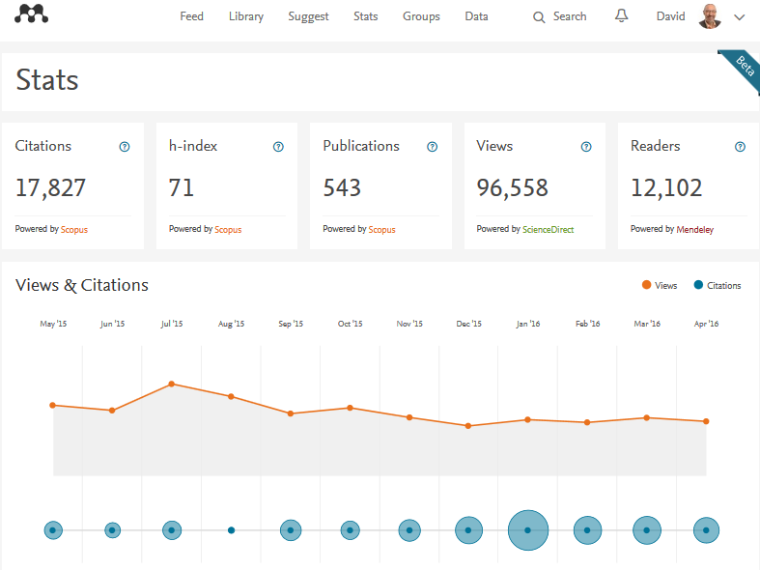
Monitoring your article: www.mendeley.com/stats

Slide 41
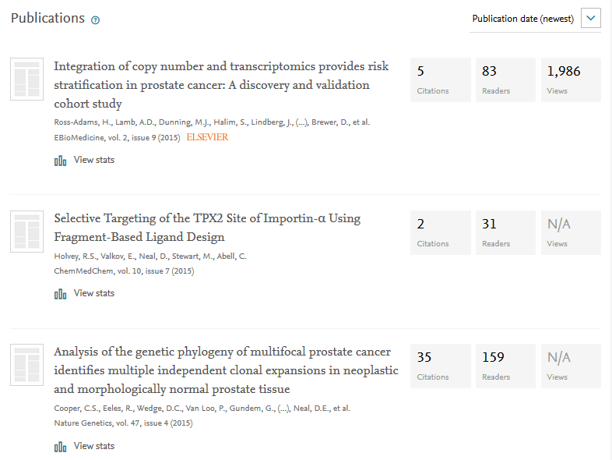
www.mendeley.com/stats
Sorting options

Slide 42

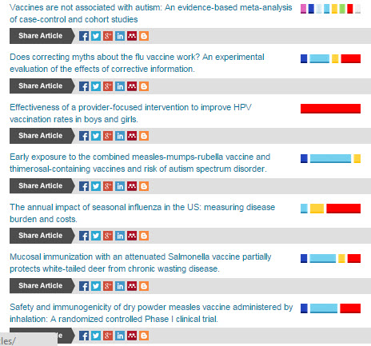
Upcoming: social media tracking
Notes:
Who’s talking about papers online and what’s being said? Altmetrics allow you to track and analyse online activity around your article.
Online article mentions are monitored from social media sites, science blogs, many mainstream media outlets and special interest publications for mentions of academic papers. You can find altmetrics information on Scopus, ScienceDirect and on many journal homepages on Elsevier.com.
Colorful visuals illustrate the engagement of the social media communities with articles in the specific journals. Rankings and scores are based on the amount and relative weight of the mentions on Twitter, Facebook, Wikipedia, science blogs and mainstream news media.
Elsevier is developing even more sophisticated tools, to give you the most optimal insights in the world of online media engagement.

Slide 43
Questions? Want the slides?
m.twisk@elsevier.com
Notes:
In this module (or presentation) we will explain to you the key principles of authorship in academic publishing together with the responsibilities that come with being an author.

Slide 44
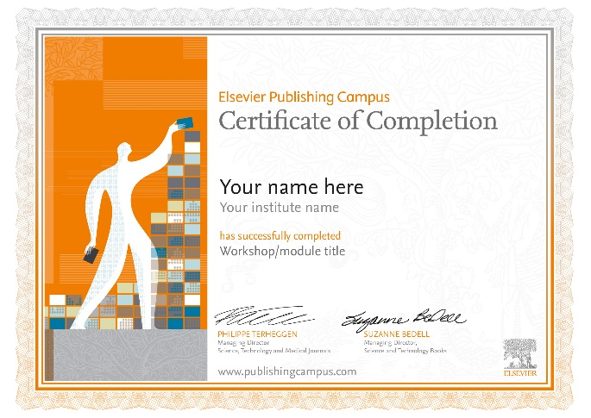
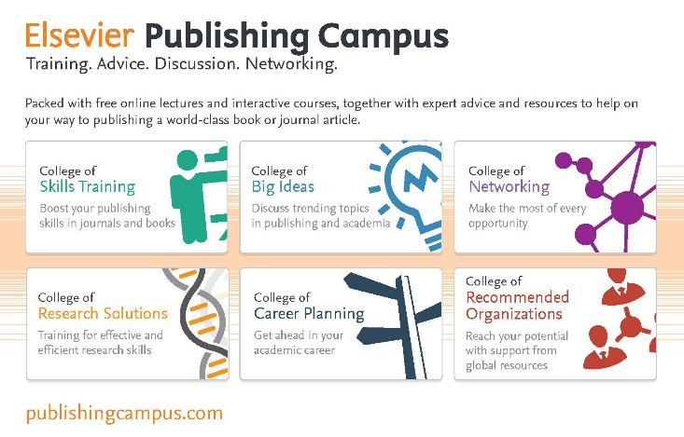
Download your personalized Certificate of Completion for this workshop now!
Enter the unique code: KZVUI
at
https://www.publishingcampus.com/workshops
As a new visitor, you will be prompted to register before completing a short survey about the workshop and downloading your certificate.
Need help?
Send email to publishingcampus@elsevier.com
Notes:
The Elsevier Publishing Campus is an online platform offering free lectures, training and advice to support each stage of the researcher’s career. Whether you are interested in writing a journal article or book, learning how to conduct peer review for a high impact journal, understanding research and publishing ethics or preparing a successful grant application, the Campus has resources to assist.
Dedicated training takes time and effort and we believe successful researchers should be recognized for this. For each interactive training module or online seminar that you complete, your work will be recognized with an awarded certificate from Elsevier.

